Slide 1

Yuxiang ZHANG
14/11/2024

Slide 2
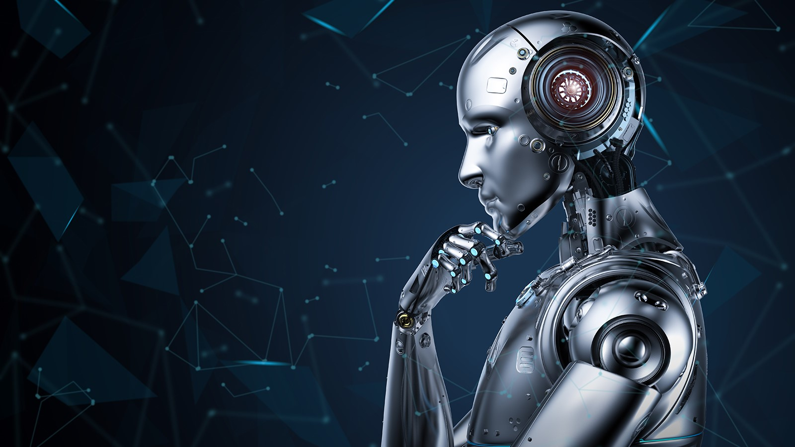
Will A.I. TRANSFORM Restaurants In The Future?

Slide 3
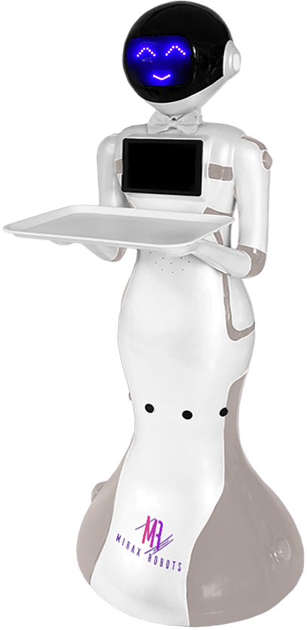
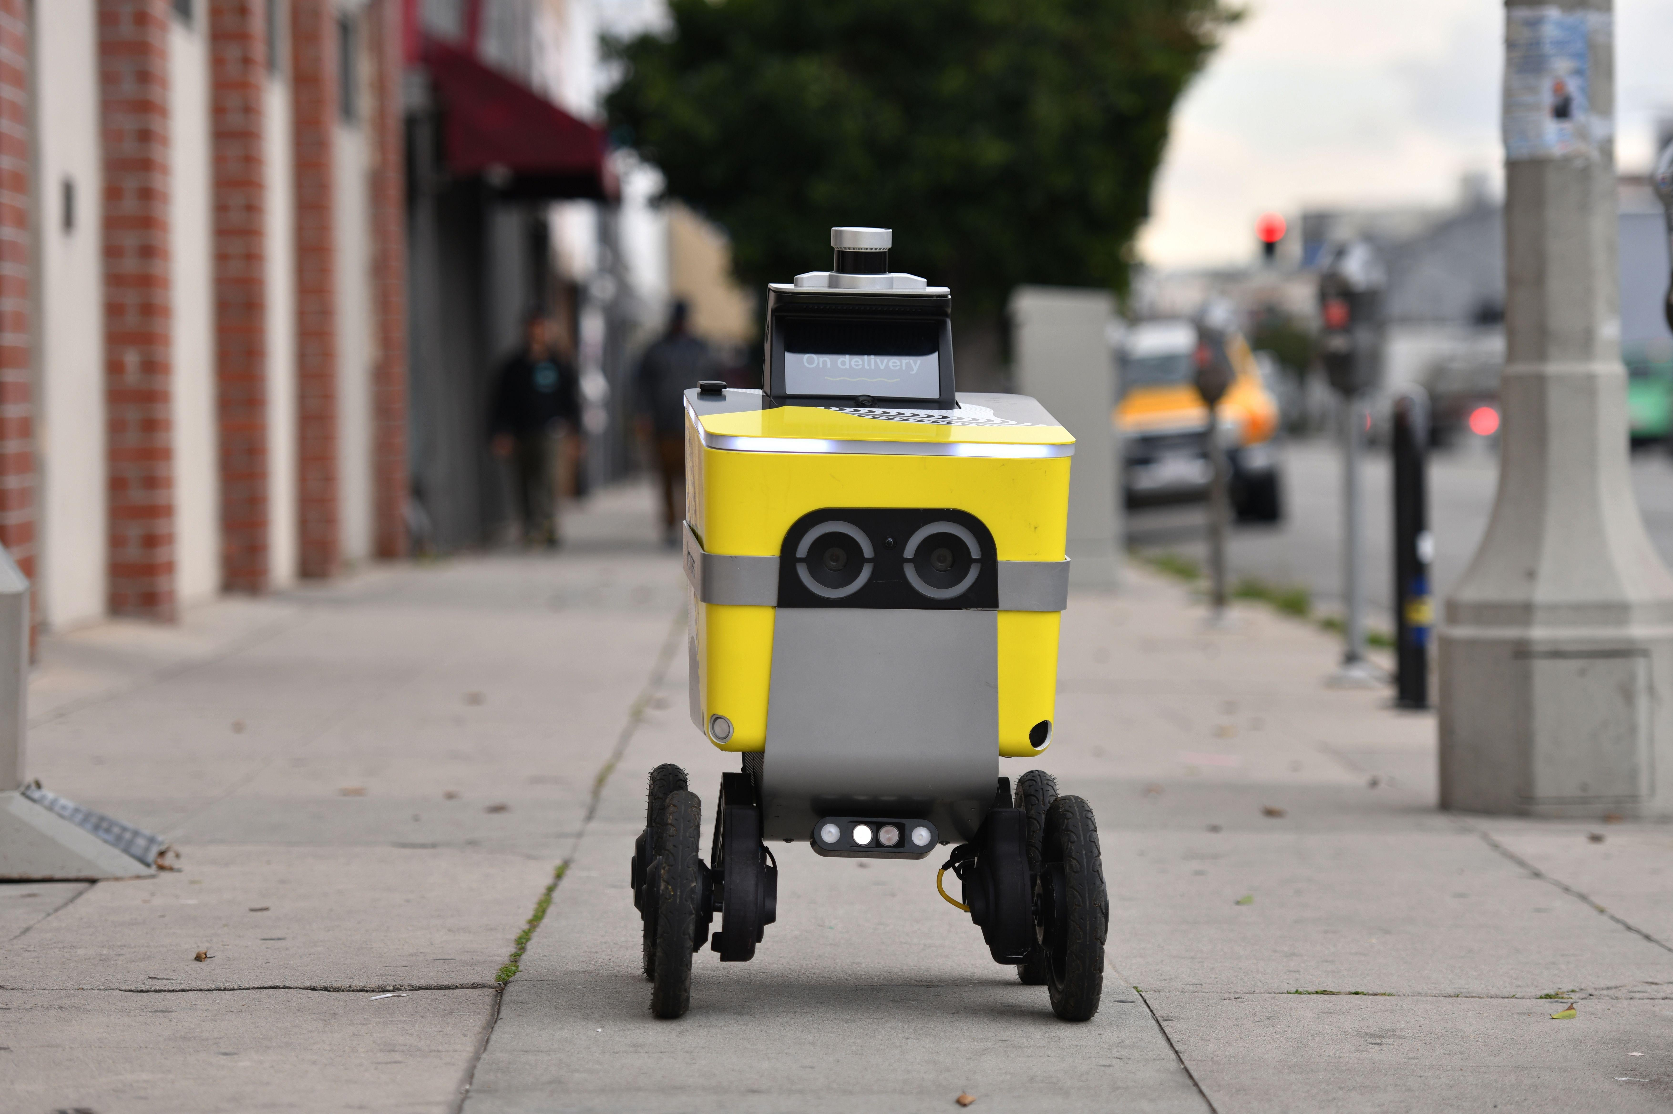
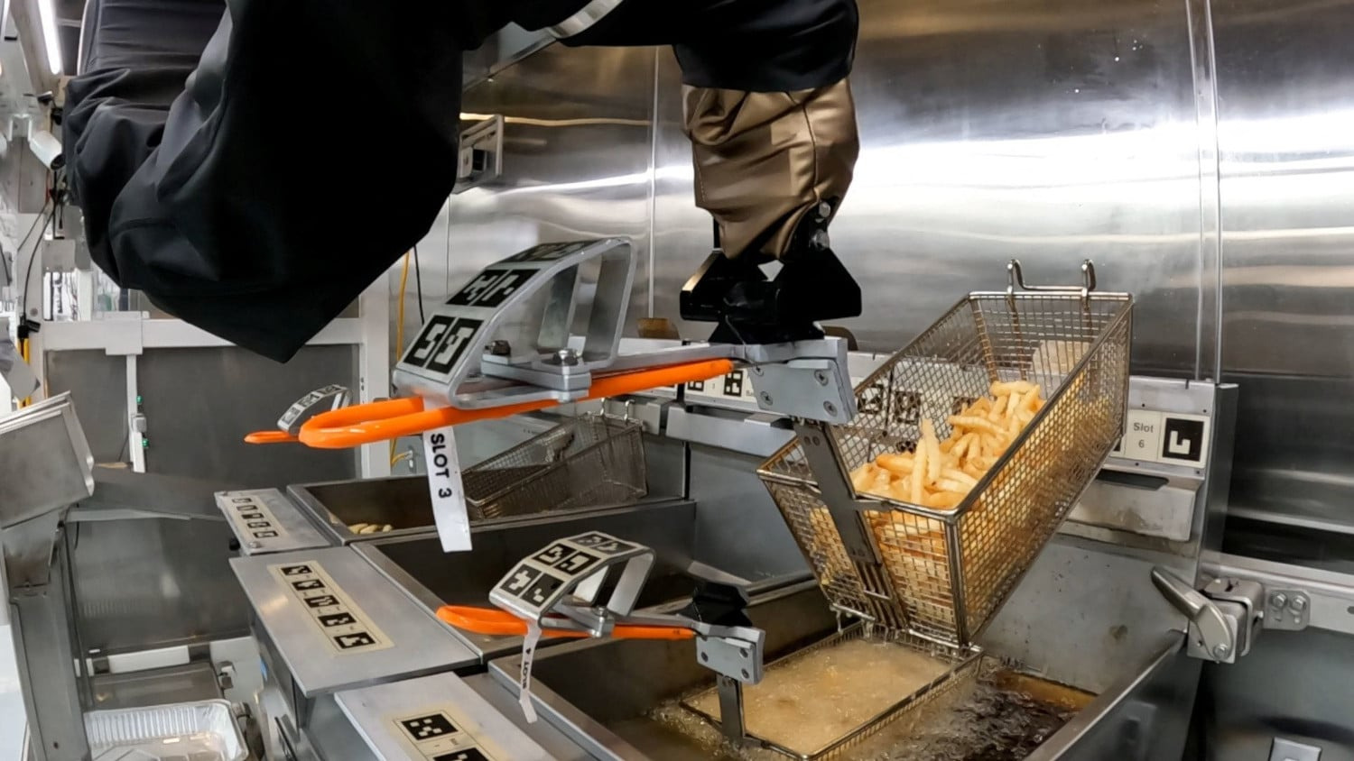
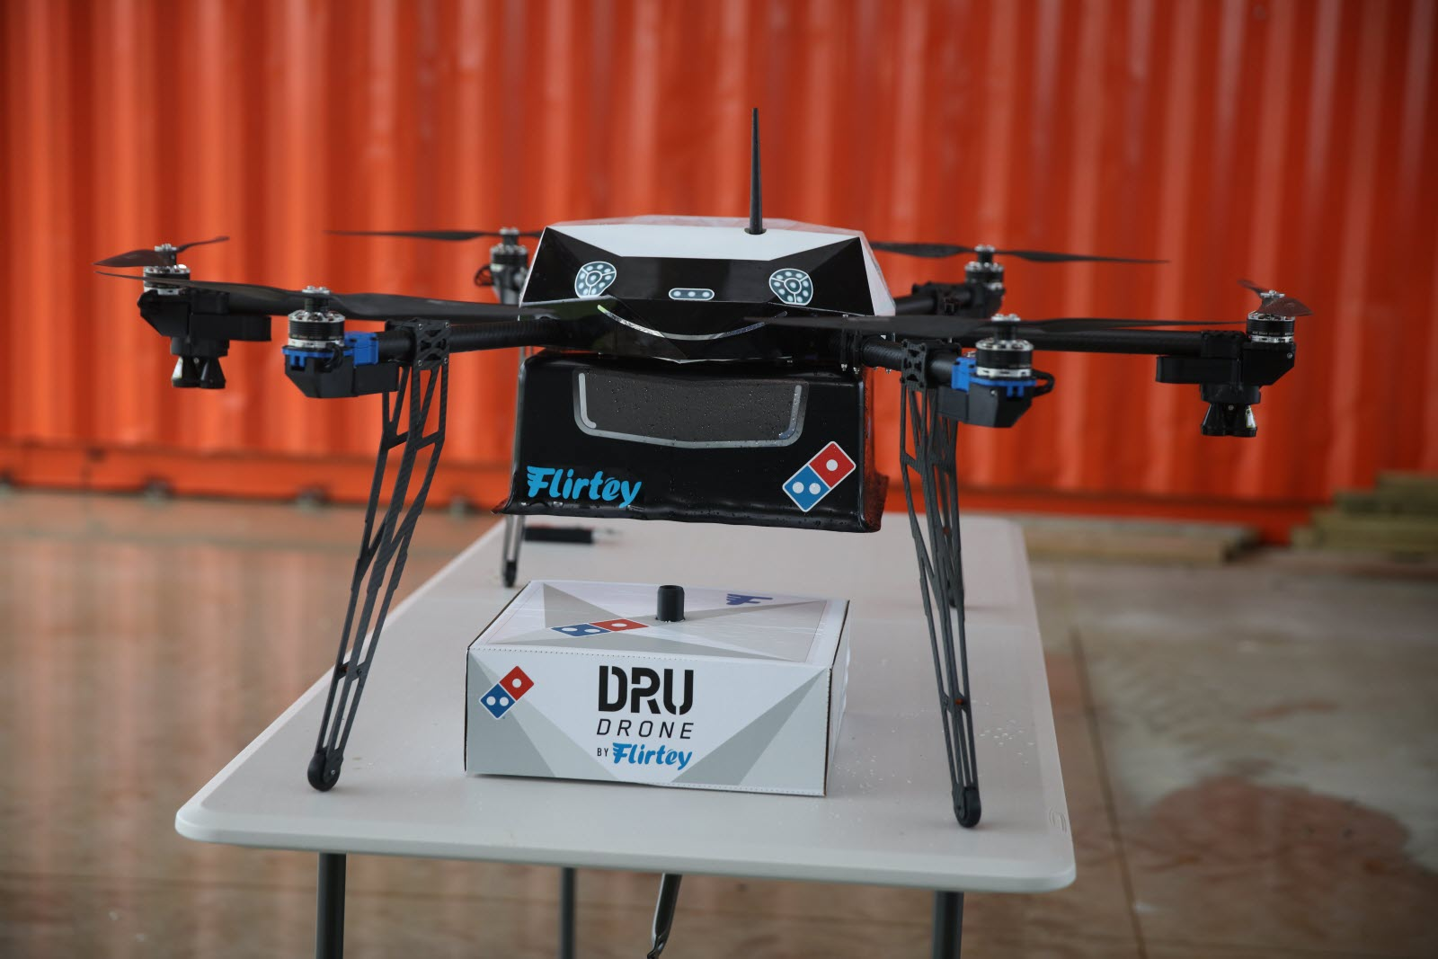
Robots in/outside the restaurants
Kitchen Robots for Cooking Assistance
Delivery Robots for Food Service

Slide 4
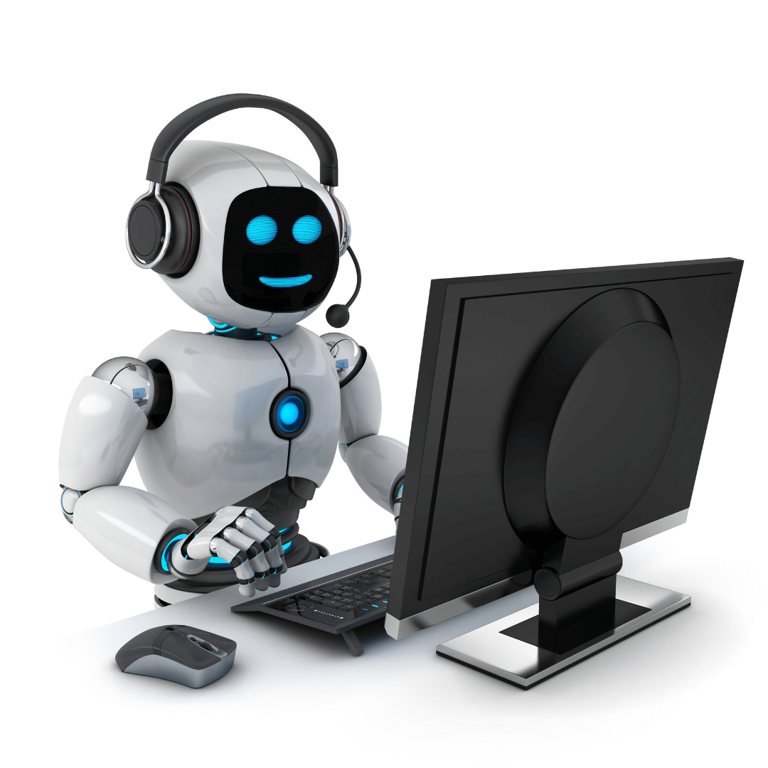
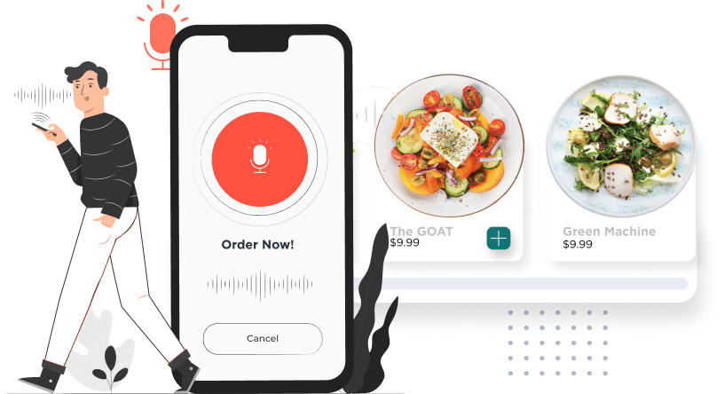
AI Phone Answering
Voice Ordering

Slide 5
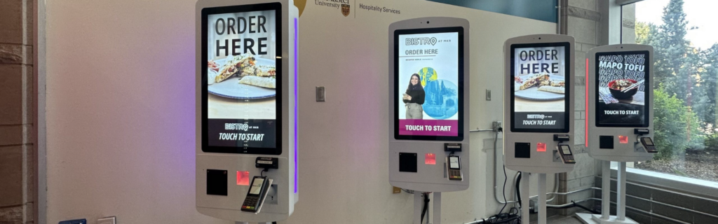
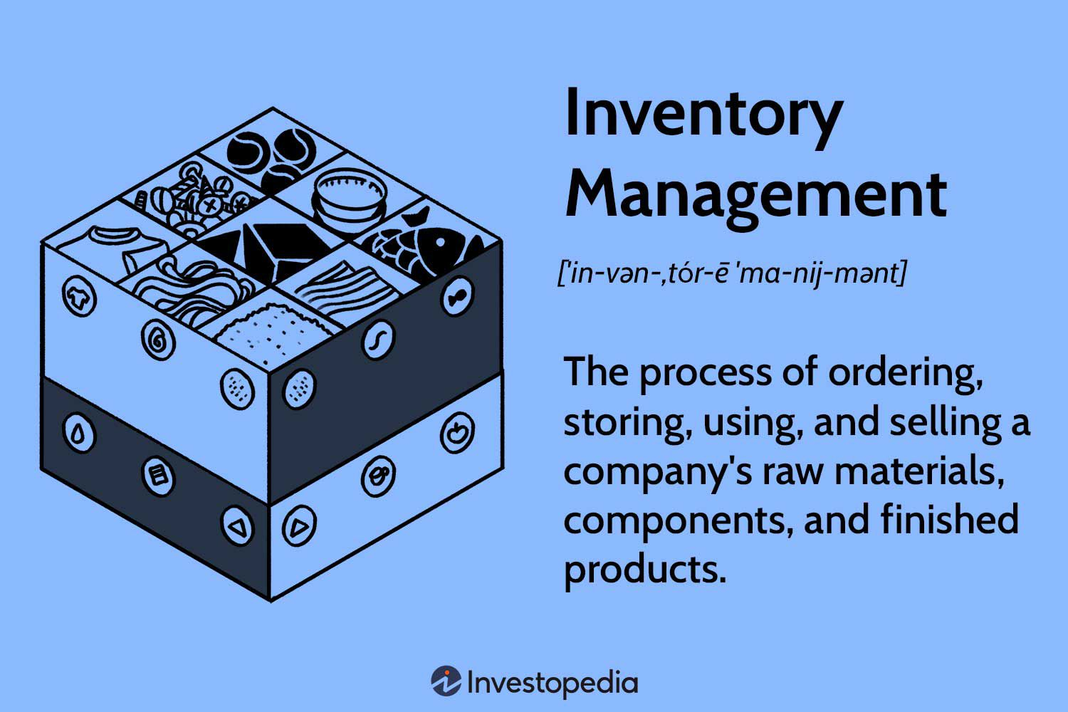
Personalised Kiosks
Inventory Management

Slide 6
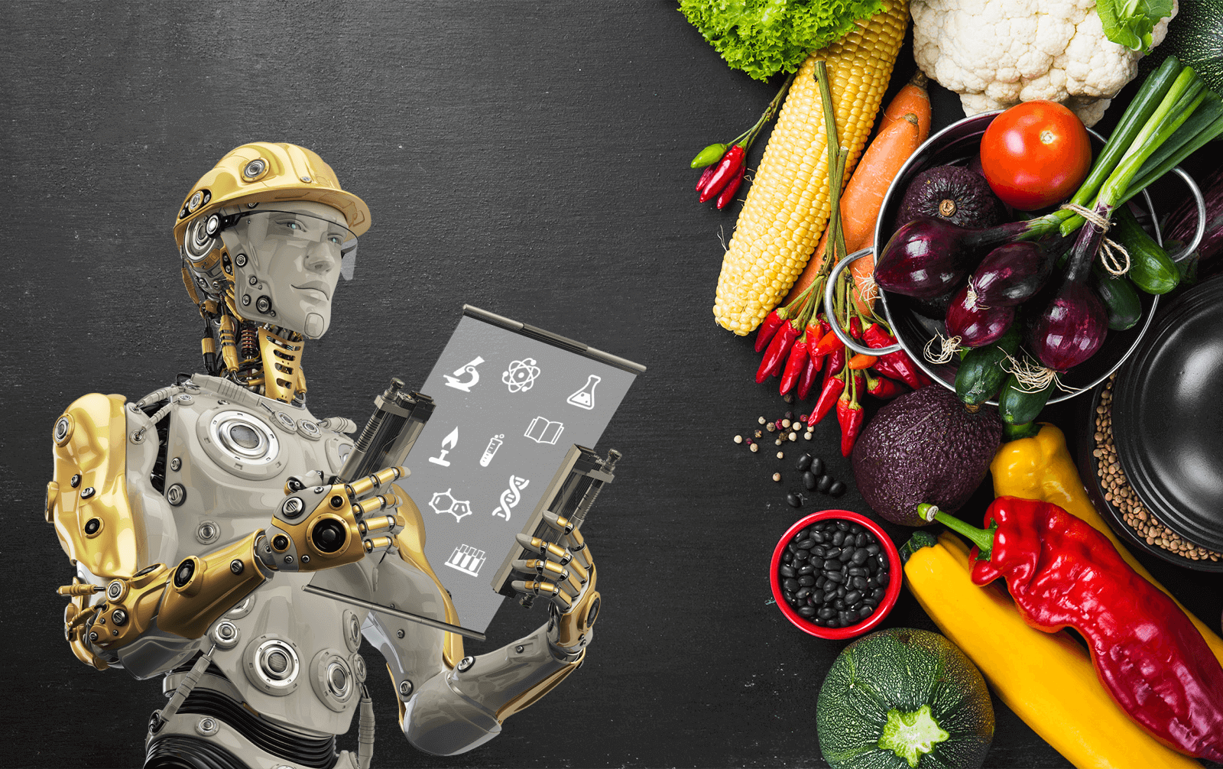
Conclusion

Slide 7

Source
https://www.youtube.com/watch?v=n14qRFixuFo
7 Ways A.I. Will TRANSFORM Restaurants In The Future (by Foodverge)
https://www.ottomate.news/p/miso-robotics-announces-flippy-2
Miso Robotics Announces Flippy 2 for Automated Frying(by Christopher Albrecht)
https://ouster.com/insights/blog/postmates-selects-ouster-lidar-for-autonomous-delivery-rover
Postmates Selects Ouster for Autonomous Delivery Rover(By Derek Frome)

